Slide 1
Universal city
Guide line
Our project is divided into two parts :-
1-website for student reservation.
2-database for internal management

Slide 2
enable the students:-
1-the website.
1- to reserve online.
2-to know the result of reservation .

Slide 3
2-database
Enable administrator to :-
1-control in student management by:-
1-search for specific student.
2-modify students data.
3-delete student from database

Slide 4
2-control in employee management by (cont):-
1-add employee in the database.
2-modify employees data.
3-delete employee data.

Slide 5
Disadvantages of the old system in the universal city :-
1-students must come to reserve.
2-the number of the employees are large.
3-There are large number of papers which may be lost
4-data students and employees may be lost .

Slide 6
Advantages of our system:-
1-reservation have become easy and comfortable .
2-the number of employees have become small.
3-there are security in students and employees data.
4-reduce the money for universal city .

Slide 7
Steps of improvement :-
1- Analysis phases.
2-Design phases.

Slide 8
2-feasability analysis .
Analysis Phases :-
1-system request.
3-work plane.

Slide 9
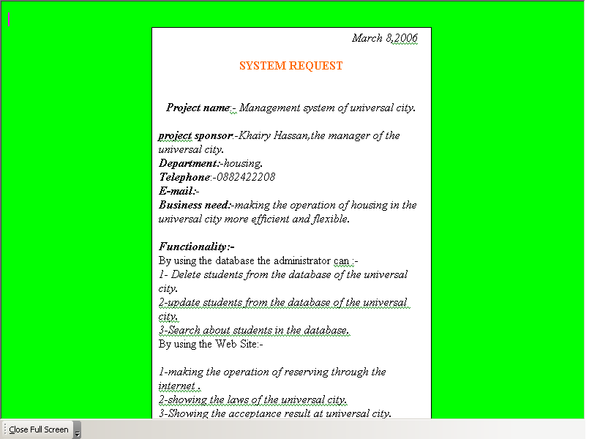
System request

Slide 10
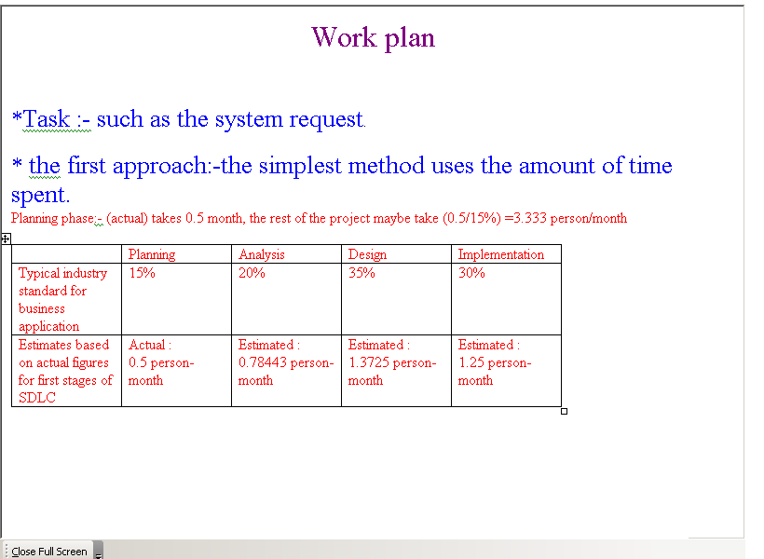
Work plane

Slide 11
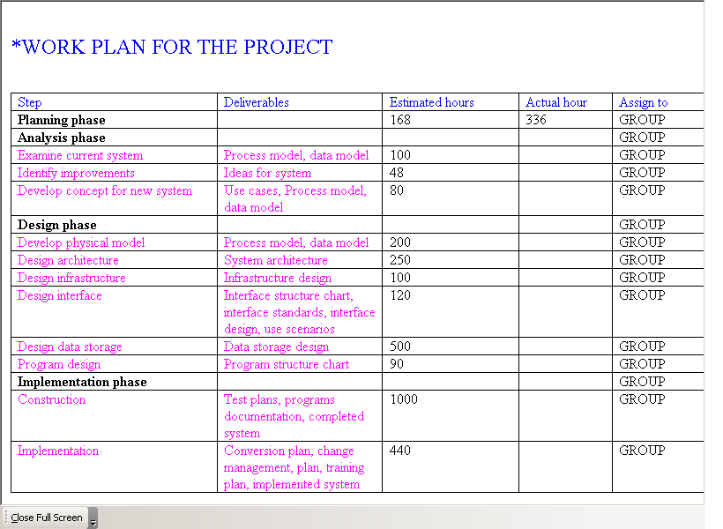
Work plane (cont):

Slide 12
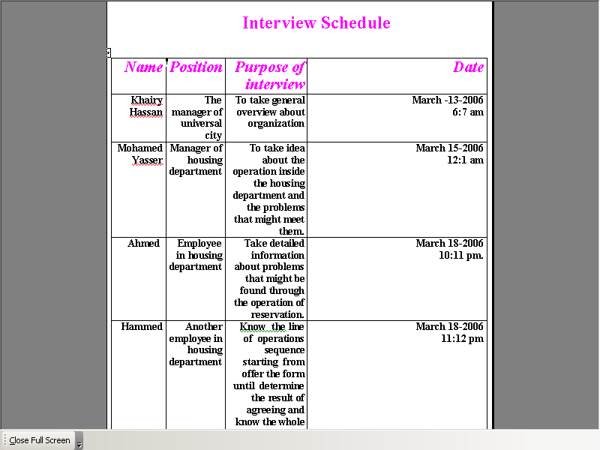
Interview report:-

Slide 13
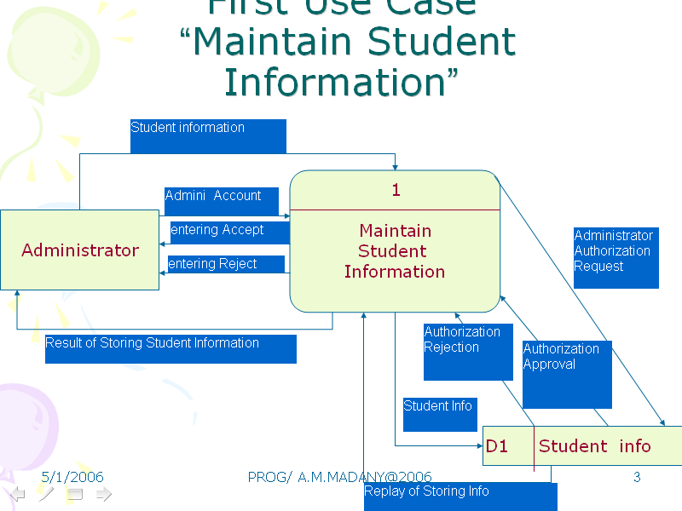
Logical model

Slide 14
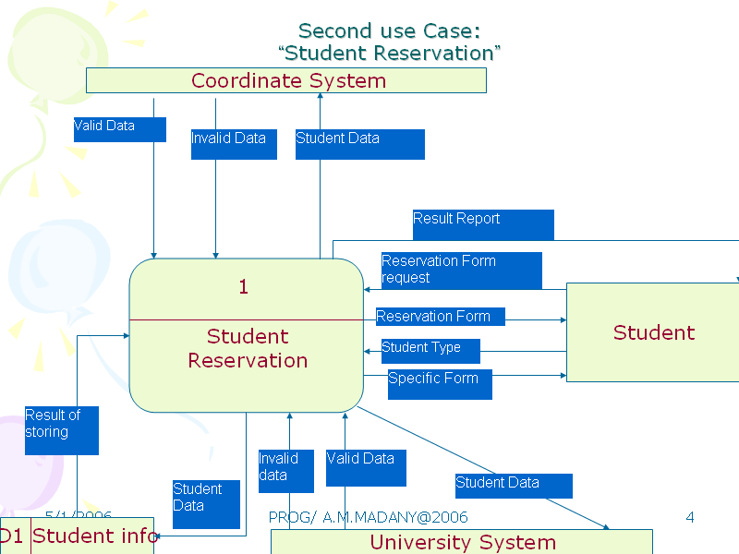
Logical model (cont)

Slide 15
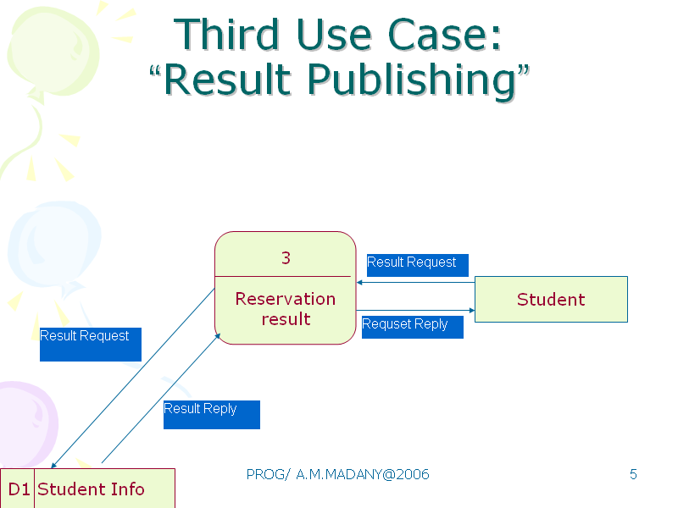
Logical model (cont)

Slide 16
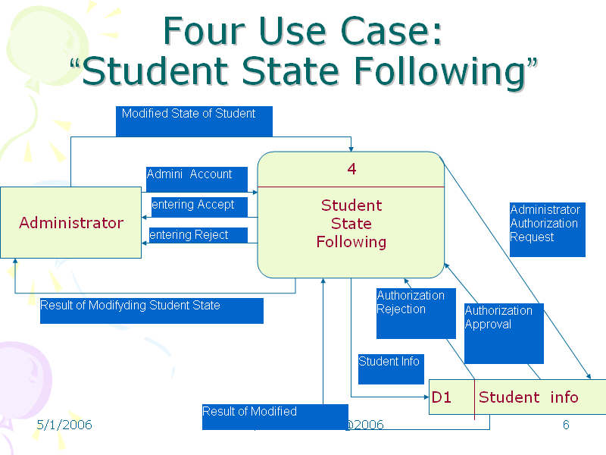
Logical model (cont)

Slide 17
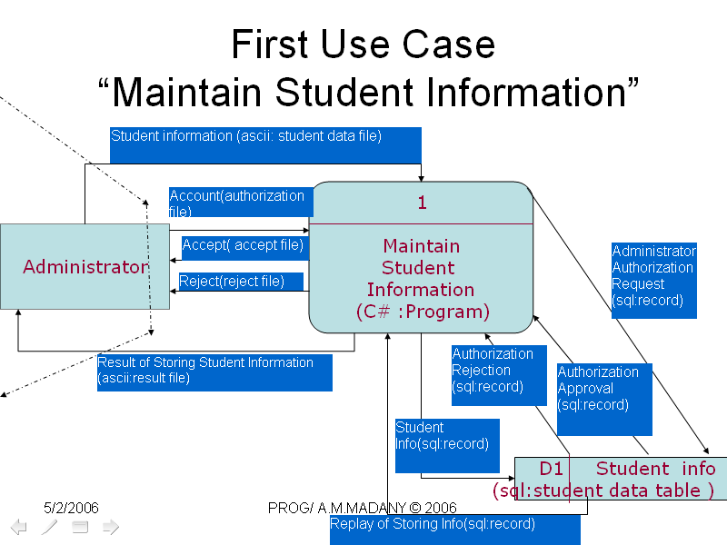
Physical model

Slide 18
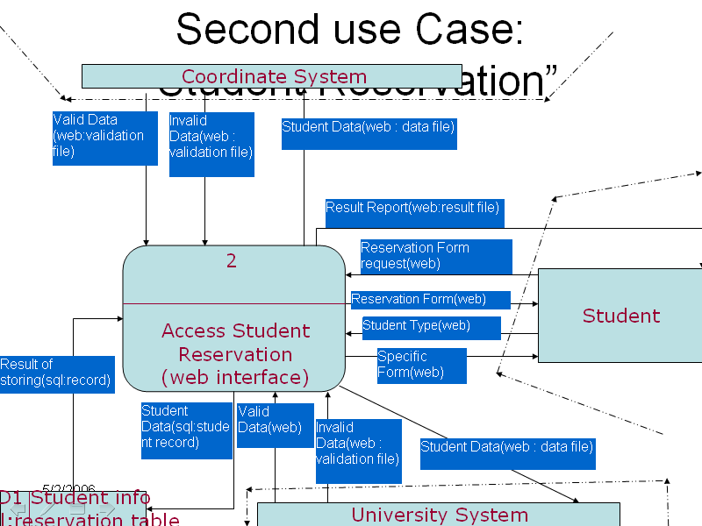
Physical model (cont)

Slide 19
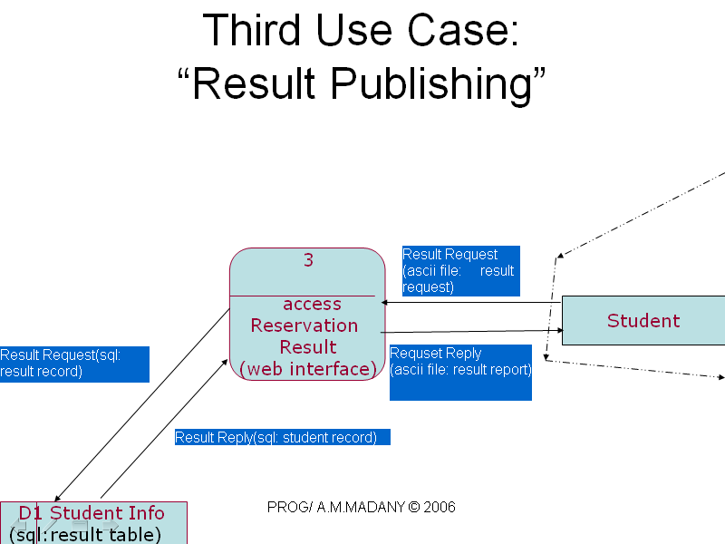
Physical model (cont)

Slide 20
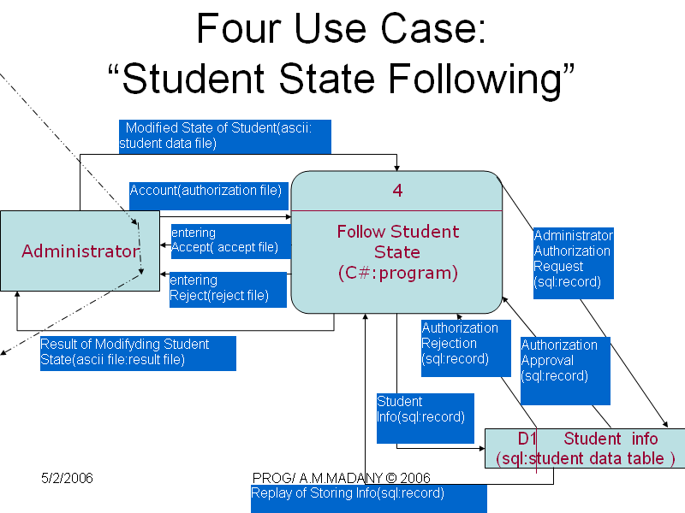
Physical model (cont)

Slide 21
The member of the group:-
1-Ossama Mahmoud Abdelnaeem Sec(1) .
2-Ahmed Monir Fayik Ahmed Sec(1).
3-Ahmed Mohamed Madny sec(1).
4-Abdelshafe Elsayed Ahmed Ahmed Sec(4).

